Slide 1
Monkeypox Misinformation on Twitter
Team Amazing:
Alicia Beckham,
Samanta Benjamin
Myrna Castro
Chrystal Martin
Enkhzaya Nyam-Ochir Celestine Schwenneker
Notes:
Chrystal
Thank you for joining us for our final presentation- The title is Monkeypox misinformation on Twitter….. Lets meet our team..

Slide 2
Alicia Beckham
Educational Background
Bachelor of Science-Business Administration
Associate of Science-Business
Employment Experience
Financial Client Service Associate

Slide 3
Samanta Benjamin
Education
AS in Radiologic Technology 2019
BS in Healthcare Management 2021
Certification:
Certified Nurse’s Assistant 2012
Phlebotomy-2017
RBT 2020
Data Science 2022
Career Background
Nearly 15 years in health care and behavioral health professional
Lead Registered Behavioral Therapist

Slide 4
Myrna Castro
Education:
Bachelor of Arts in Biology, Minor in Mathematics
Certification:
Esri ArcGIS
Career Background:
United Nations Office for the Coordination of Humanitarian Affairs – Programme Management Officer, Crisis Response Coordinator

Slide 5
Chrystal Martin
EDUCATION
B.S Sociology 2009
Certificate Medical Billing 2012
Certificate Ambulance Billing 2019
Certificate Data Science 2022
EMPLOYMENT
Pre-School teacher
Senior Billing Specialist
Administrative Assistant

Slide 6
Enkhzaya Nyam-Ochir
Education:
Bachelor of Science in Psychology
Career Background:
Proposal Writer in Business Development for IT company
Compliance Analyst for a Manufacturing Company

Slide 7
Celestine Schwenneker
Education:
Human Service, A.S
Legal Studies, B.A
Management and Organize Leadership, M.S
Certification:
Data Science and Project Management
Career Background:
Non-Profit Business Developer,
Community Organizer and Education Prevention,
Data Administrator and Project Management.

Slide 8
Project Introduction
Our objective is to identify how much misinformation can spread on Twitter:
Does the status of the user impact the spread of information?
Question 1- What is the comparison of tweets on monkeypox misinformation that were verified vs unverified users?
Question 2 - Does the number of followers that a user have impact the retweets?
Notes:
Alicia,
Objective of the project is to identify how much misinformation can spread
Health concerns on Twitter platform is what initiated this project
The status of a tweet can affect the spread of information
What is the comparison of the tweets on monkeypox misinformation that were verified vs unverified users?
Does the number of followers that a user have impact the retweets?
Using the monkeypox data set
Measure these parameters using statistical and quantitative analysis
Tools includes data wrangling, python, and visuals to interpret

Slide 9


Background
Twitter
The state of Twitter
Twitter now
Monkeypox (MPOX)
Monkeypox is a viral zoonosis (a virus transmitted from animals to humans) with symptoms similar to those seen in the past in smallpox patients.
Notes:
Alicia
Twitter?
Twitter is a social network service incepted, in 2006, for individuals to stay connected
People post Tweets that could be photos, videos, links and text
…to their profile so that their follower can see
With the possibility of retweeting that same post
State of twitter at the time of research…
Twitter’s blue check mark was originally a way to prove users' identities
October, Elon Musk officially took ownership of Twitter
Twitter now?
Blue for individuals
Manually authenticated
What is monkeypox?
Documented in 1970
Monkeypox is a rare infectious disease caused by infection with the monkeypox virus.
First current outbreak was identified on May 2022.
July 23, 2022 WHO declared a public health emergency

Slide 10
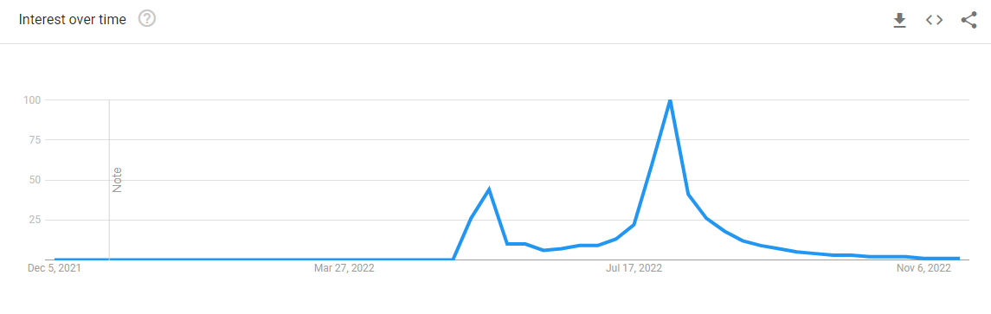
Google Trends on Monkeypox
Notes:
Samanta:
Initial spike begin prior to the dataset 1 and dataset 2 was collected after the second peek. Which indicates that the datasets does not include the Virality.

Slide 11
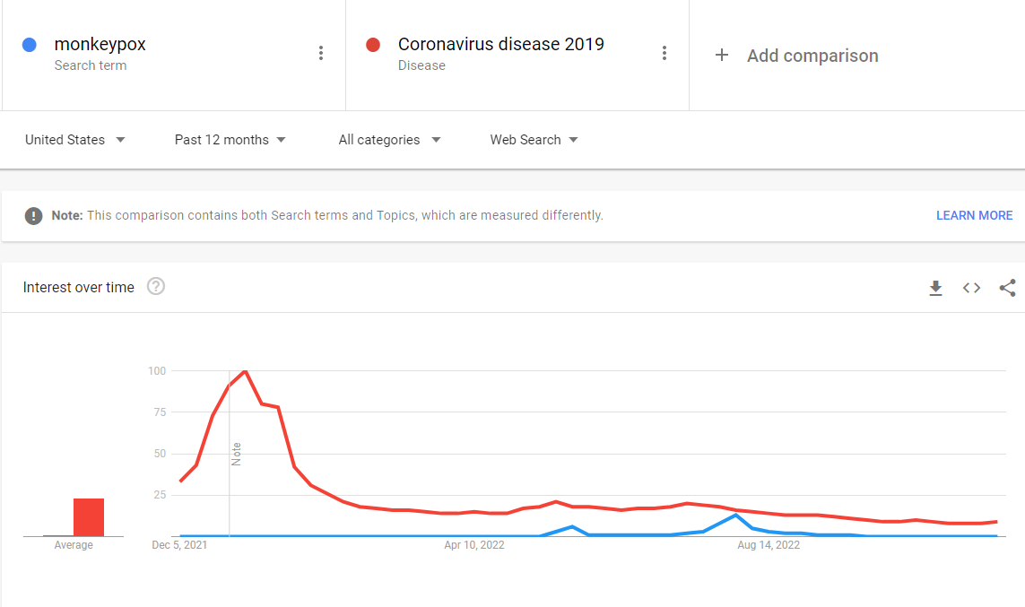
Notes:
Samanta:
The popularity of monkeypox was far less compared to COVID-19, and only had a short spike over time
Highlighting the 2 peeks of the datasets that began prior to the peek and after the peek. Which indicates the relevance of contacts of our tweets. The popularity of Mpox did not meet the popularity of Covid-19.

Slide 12
Methods
Monkeypox Misinformation: Twitter datasets was found on the Kaggle website this data was collected by the University of Liverpool.
This resource offers two datasets:
First dataset was collected from July 7th-13th, 2022 before the peak of interest.
19 columns of data.
5787 tweets.
402 verified individuals accounts.
5385 unverified individual accounts.
Second dataset was collected from August 30th, 2022 after the peak of interest.
20 columns of data.
500 tweets.
57 verified individual accounts.
433 unverified individual accounts.
Notes:
Celeste
We found our Monkeypox Misinformation: Twitter datasets on the Kaggle website. The mining of this data was collected by the University of Liverpool.
This resource offer us two datasets:
The first, dataset was collected from July 7th - 13th, 2022 before the peak of interest which consist of tweets published during the first week of the outbreak endemic.
The first data set consist of 19 columns of data.
And is a larger dataset consisting of 5,787 tweets.
402 verified individuals accounts.
The second dataset was collected from August 30th, 2022 which was after the peak of interest.
The second data set consist of 20 columns of data.
And is the smaller dataset consisting of 500 tweets.
Of which 57 are verified individual accounts.
433 unverified individual accounts.
First dataset was collected from July 7th-13th, 2022 before the peak of interest.
19 columns of data.
5787 tweets.
402 verified individuals accounts.

Slide 13
Methods Continued:
We utilized Python, Jupyter Notebook, and Excel to clean and analyze our statistical data.
Q1 we used 2 columns
User verified and binary class.
Analysis: Independent T-test.
Q2 we used 2 columns.
Retweet count and followers accounts.
Analysis: Simple Linear regression
Notes:
Celeste
We utilize Jupyterlab to complete our coding in Python language.
For Q1 we used 2 columns of data to perform our initial analysis for Q1 we used
Users verified and binary class as our variables.
For our Analysis we conducted a: “Independent T-test”
For Q2 we also used 2 columns of data to complete our analysis for Q2 we used
Users verified and binary class as our variables.
For our Analysis we conducted a: “Simple Linear regression”

Slide 14
Question 1 (Q1)
What is the comparison of the tweets on monkeypox misinformation that were verified vs unverified users?

Slide 15
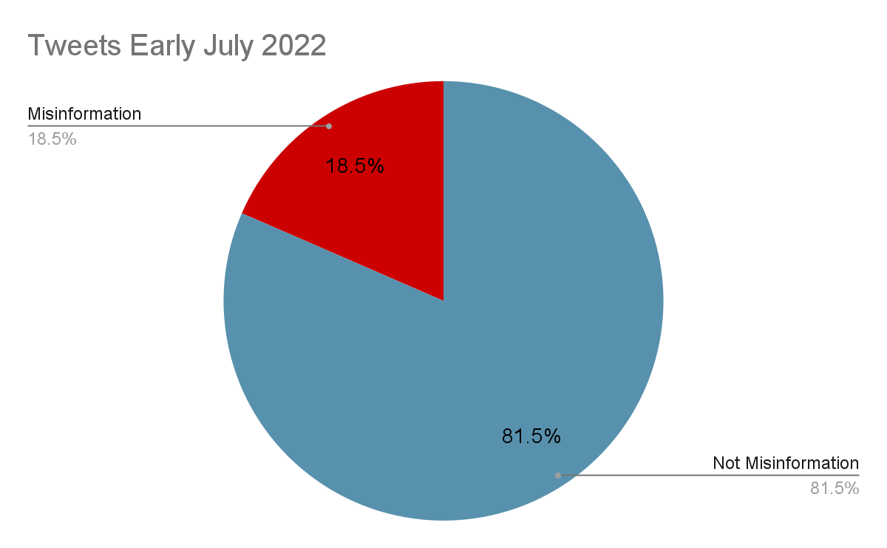
Q1 Findings- Early July Monkeypox Data
Out of all the tweets in our first dataset in July, 18.5% of monkeypox related tweets were misinformed

Slide 16
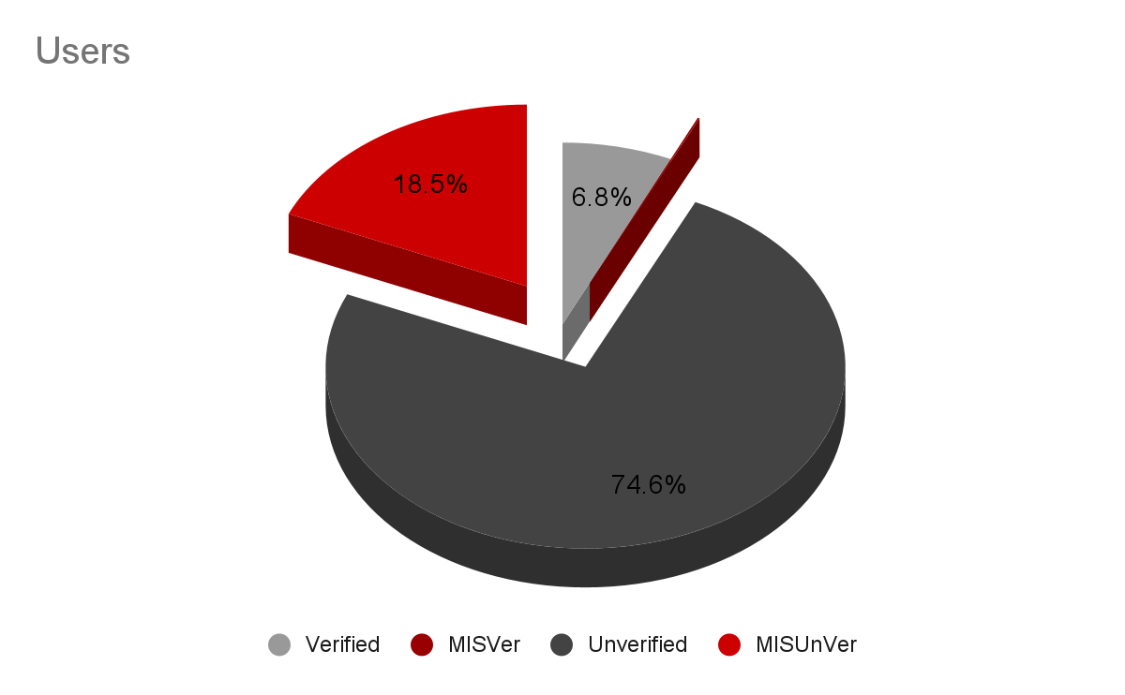
Q1 Findings - Verified v. Unverified users
Only 6.9% of the tweets were by Verified from the early July dataset
Of the verified users, only 1.7% of verified tweets were misinformed on Monkeypox
There was more misinformed tweets about monkeypox from Unverified users

Slide 17
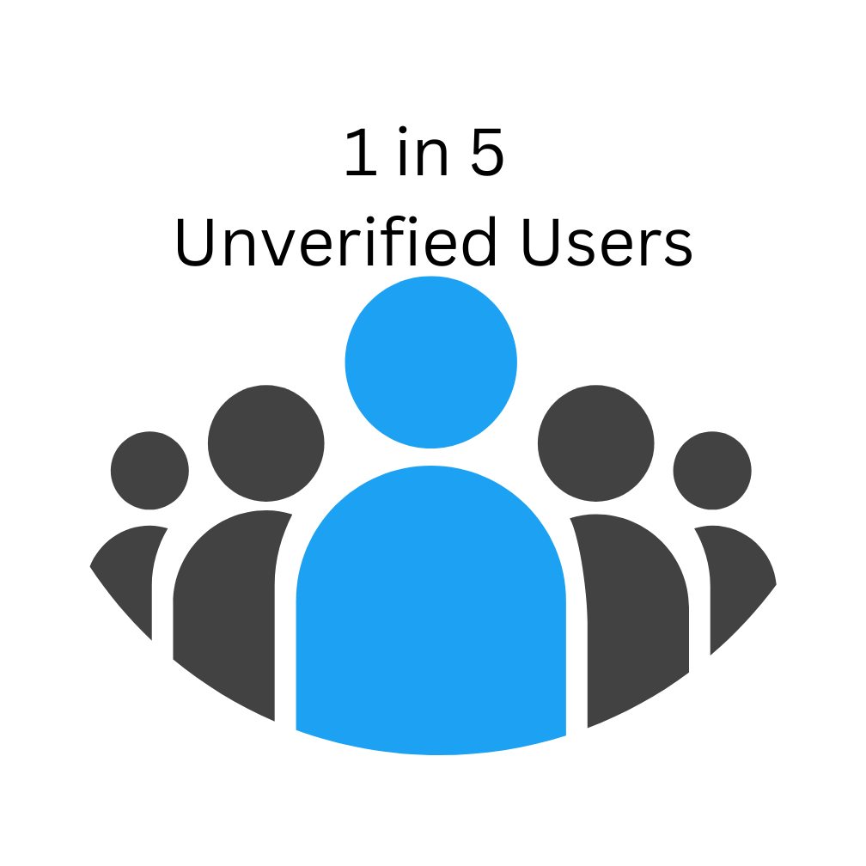
Q1 Findings - Verified v Unverified Tweets
93.1% of all tweets came from unverified users in early July
Of the unverified users on twitter, 1 in 5 tweets were misinformed tweets about Monkeypox
Notes:
There is a significance of ⅕ unverified users sharing misinfo
1/57

Slide 18

Q1 Findings - Late August Dataset
From Monkeypox Late August Dataset, 18.8% of all tweets were misinformed tweets about monkeypox
Notes:
Overtime, we wanted to see if the trend changed at all
The overall trend of misinformation on monkeypox didn’t really change

Slide 19
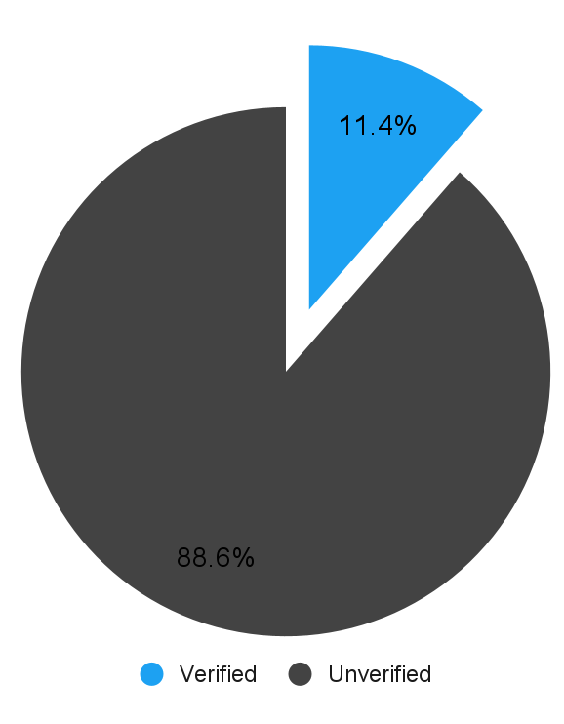
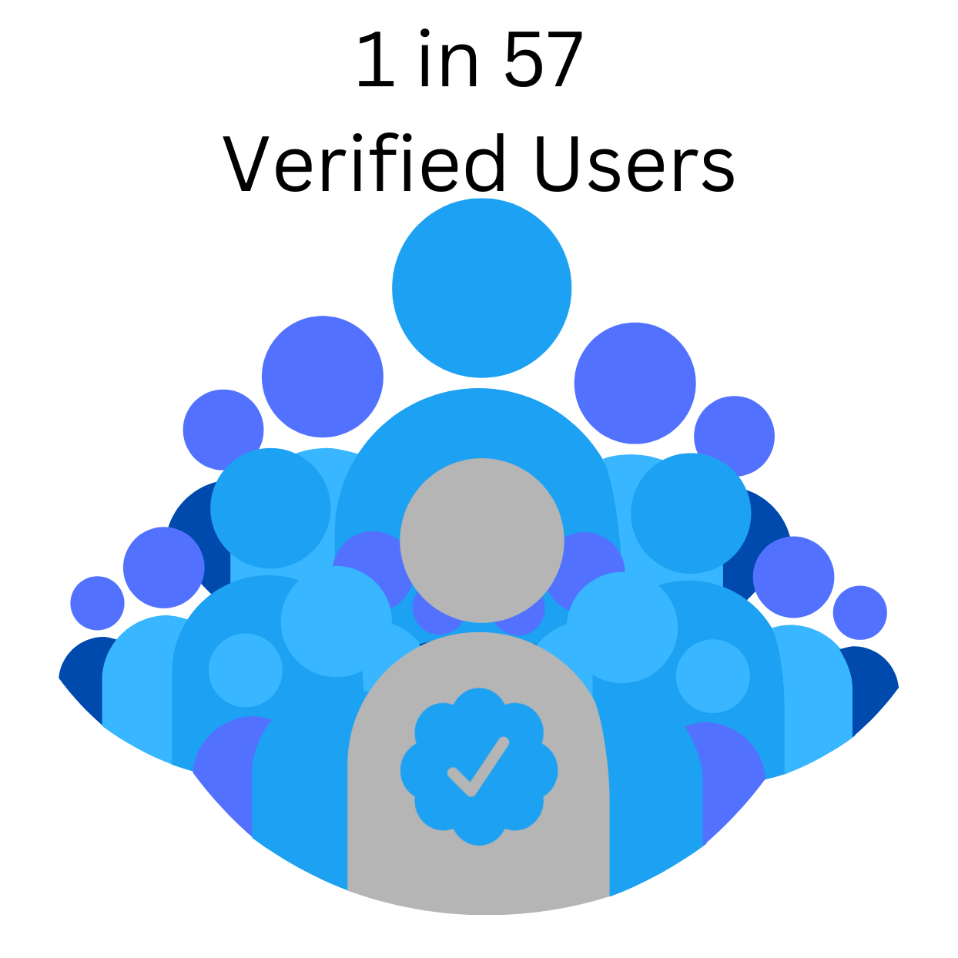
Q1 Findings
Monkeypox Follow-Up Data set 11% of all tweets came from Verified users
And only 1 in 57 verified tweets were misinformed tweets about monkeypox
Notes:
2nd dataset smaller amount of misinformed tweets coming out of verified users

Slide 20
Q1 Findings
Overall the trend doesn’t change from early July to late August
And only 1 in 57 verified tweets were misinformed tweets about monkeypox

Slide 21
Q2 Findings
Does the number of followers that a user have impact the retweets?
Notes:
Chrystal
Now for question 2– Does the number of followers that a user have impact the retweets?

Slide 22
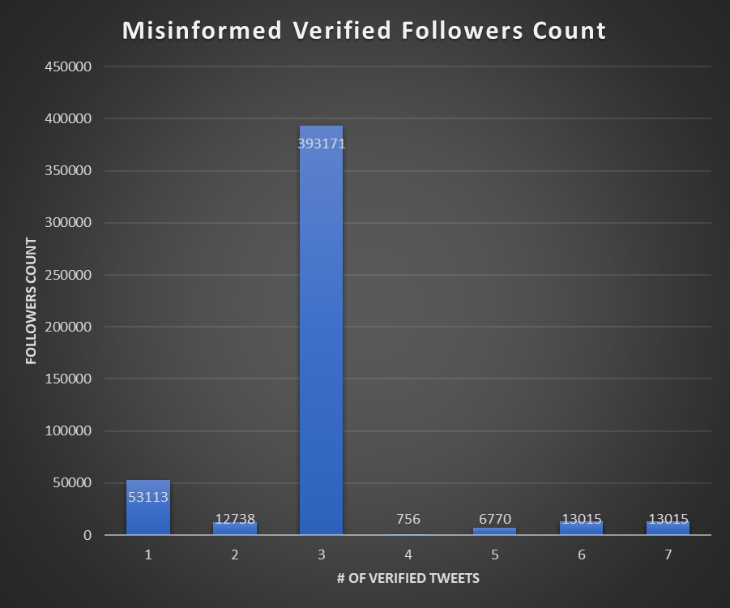
Notes:
Chrystal-
This graph shows the Misinformed tweets from Verified users and their follower Count
There were 7 verified users that tweeted misinformation about monkeypox..
This is a summary of the follower count for users..
756 were the smallest number of follower count
the largest was closer to 400, 000
The average was (70 thousand 400 hundred-)
-

Slide 23
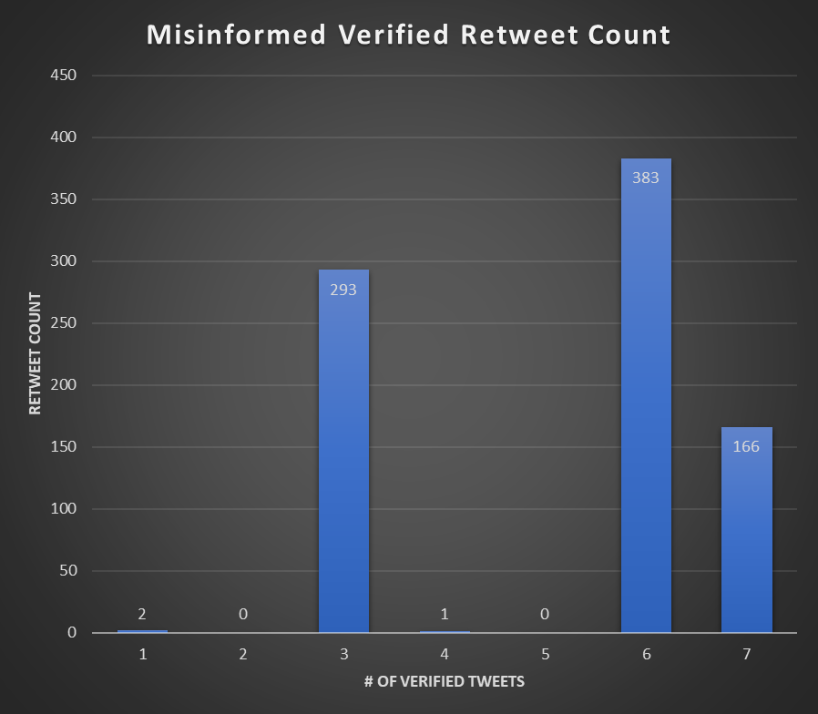
Notes:
Chrystal-
This graph shows the Misinformed Verified retweet_count
There are 7 verified tweets
-showing no retweets of misinformed tweets from verified users
– at most a single misinformed tweet from a verified user was shared close to 400 times
– on average there were about 120 misinformed retweets from all 7 verified users

Slide 24
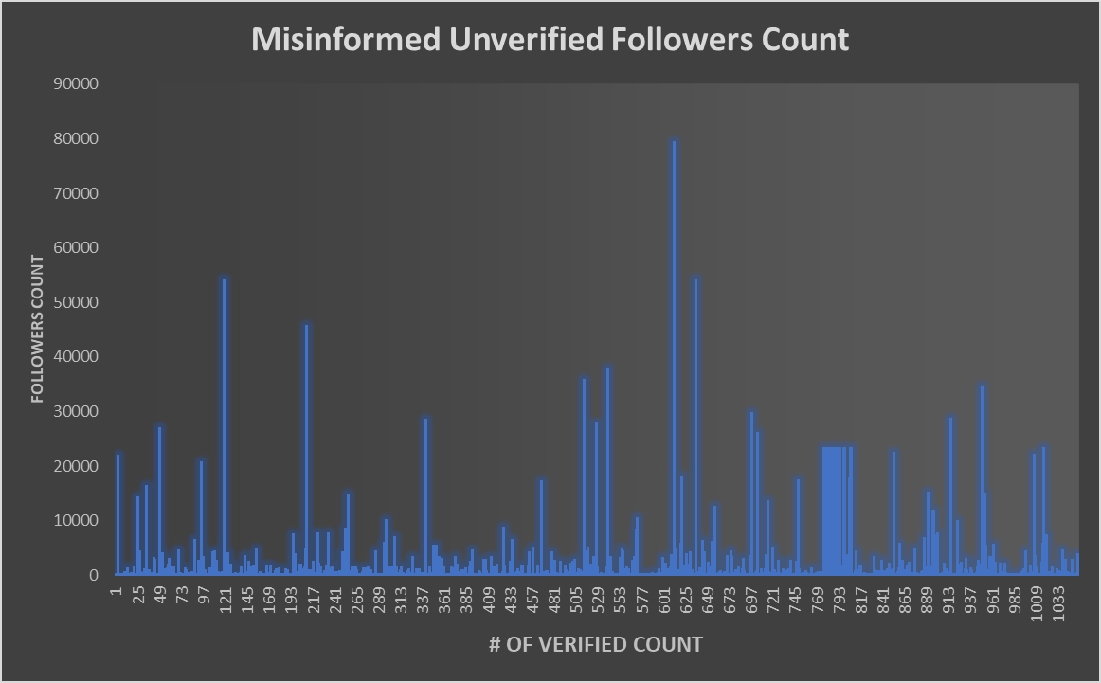
Results Q2 Graphs
The results section will be the meat of your presentation. You should divide your results section into parts by evaluation question, so that you can easily signpost things. In the results section, you will go over any of the exploratory findings you have you want discuss, as well as the answers to each evaluation question. Ensure that you provide LOTS of beautiful visuals to go along with your findings.
Notes:
Enkhzaya
Misinformed Unverified Followers Count
min 0
max 46797 with only two users having over 58000 and 80,000 followers
average 2561.326742

Slide 25
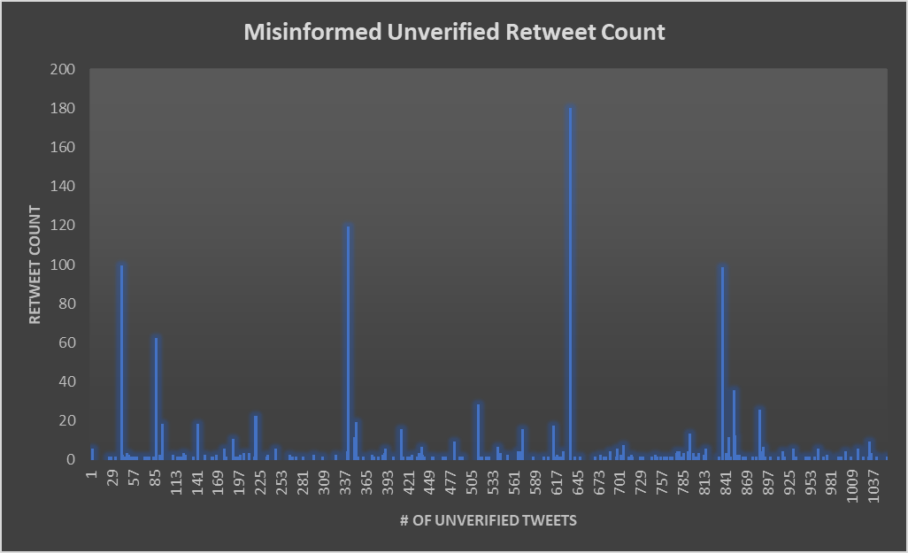
Results Q2 Graphs
The results section will be the meat of your presentation. You should divide your results section into parts by evaluation question, so that you can easily signpost things. In the results section, you will go over any of the exploratory findings you have you want discuss, as well as the answers to each evaluation question. Ensure that you provide LOTS of beautiful visuals to go along with your findings.
Notes:
Enkhzaya
Misinformed Unverified retweet_count
min 0
max 180
Average 1.132

Slide 26
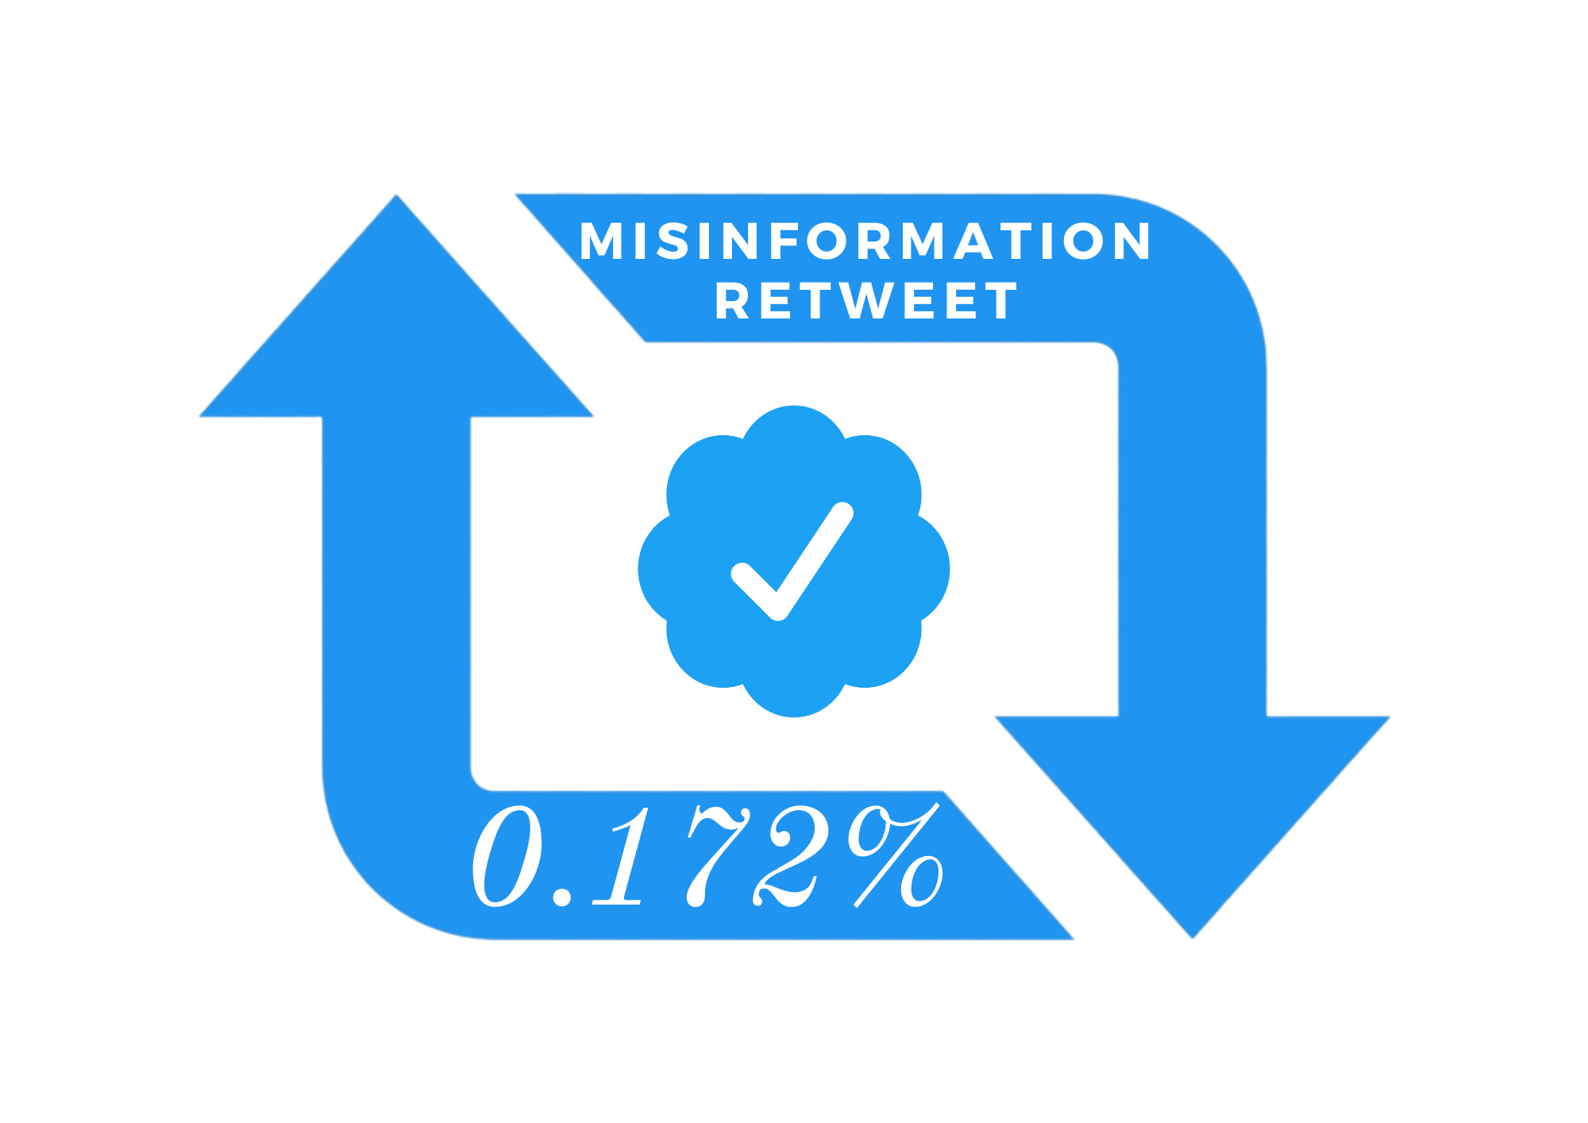
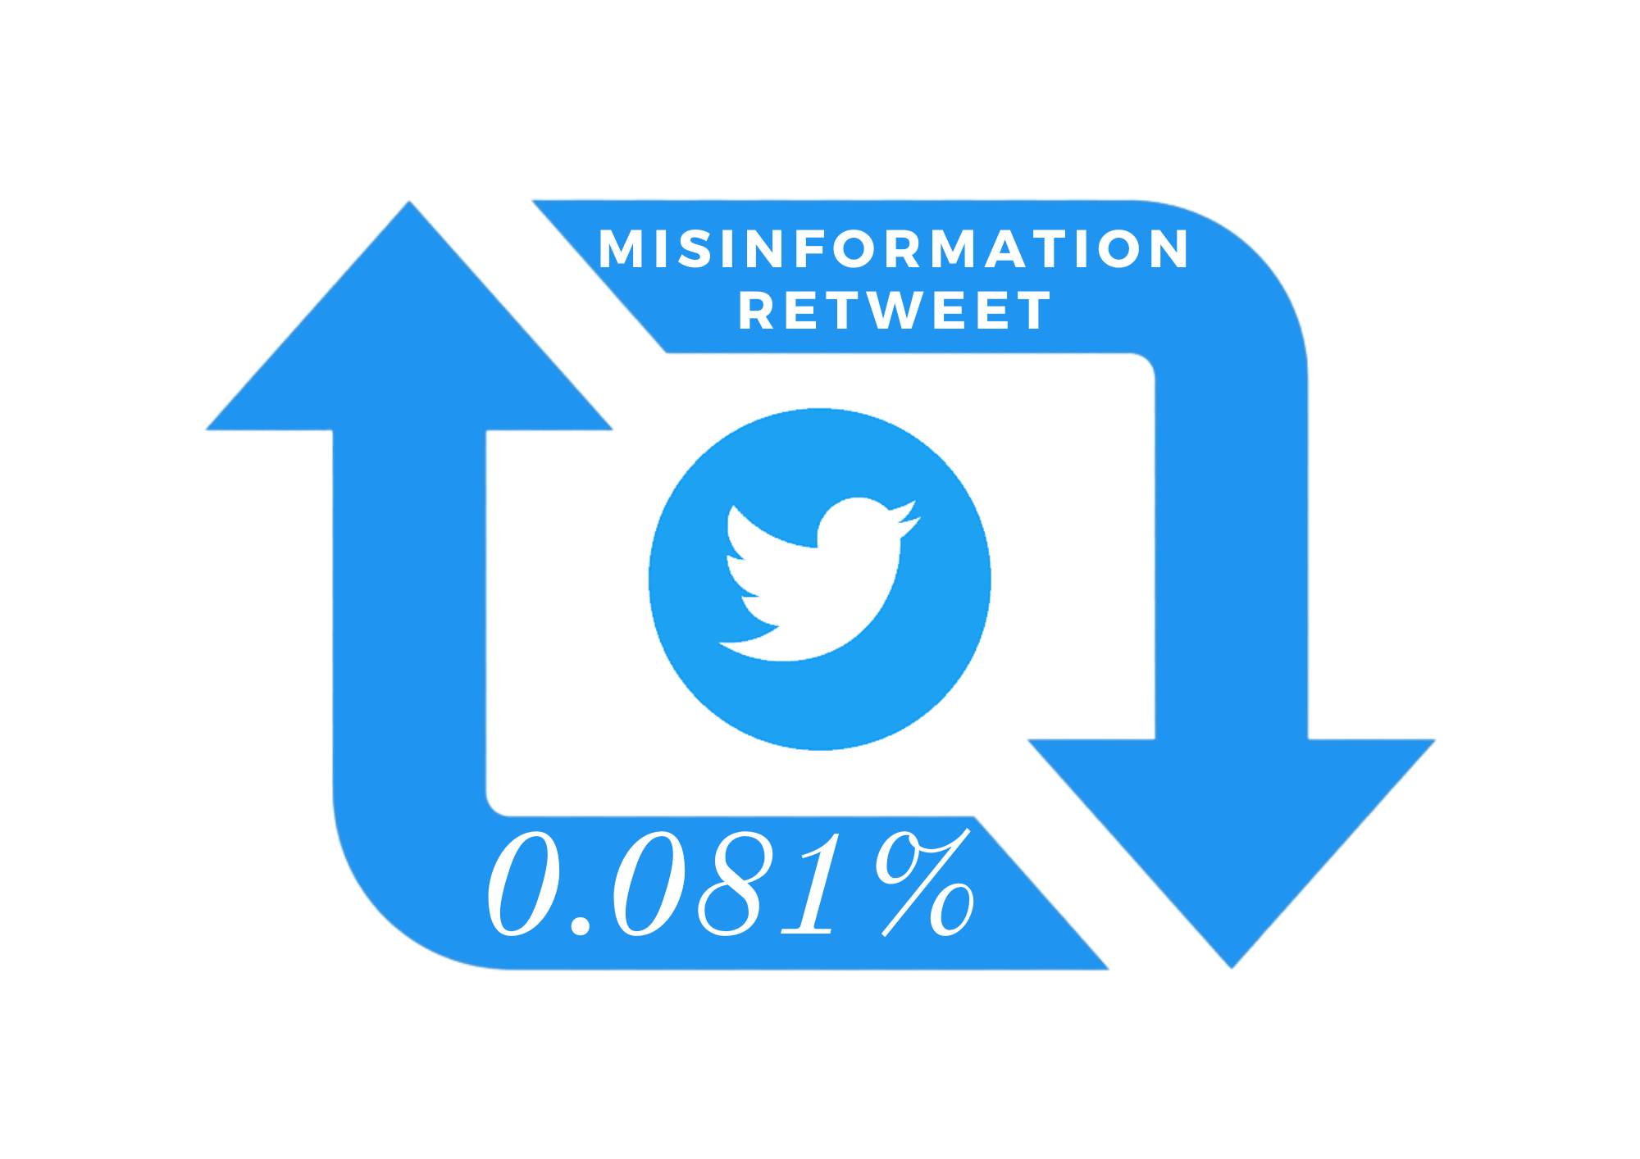
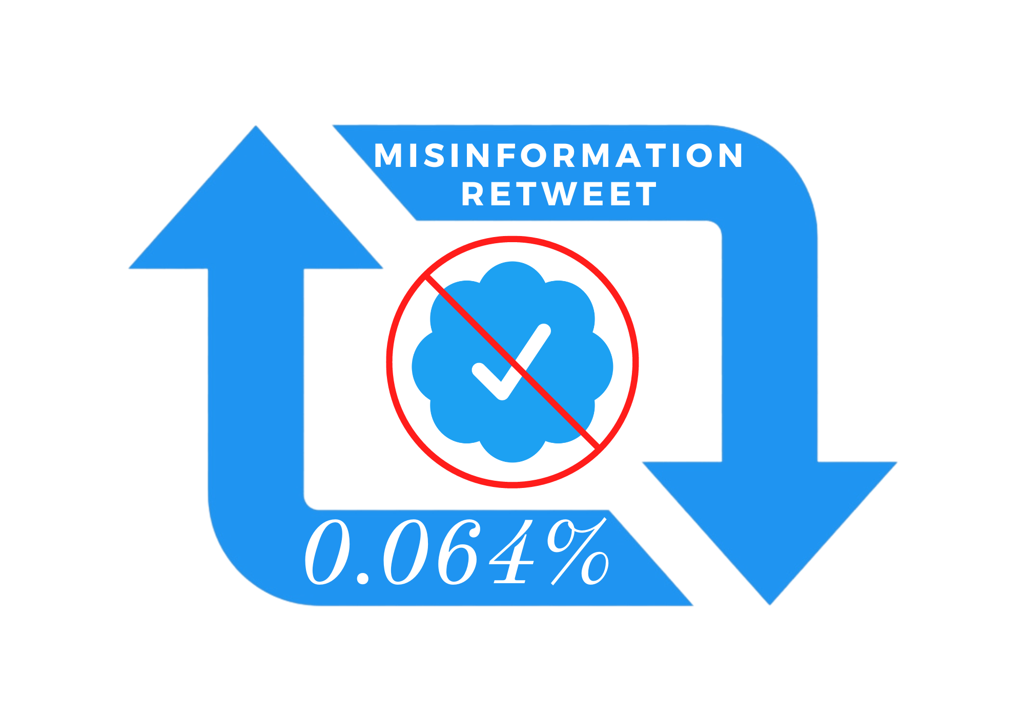
Q2 Findings - Followers and Retweet relationship
From the entire data from Early July 0.064% of retweets were from unverified users
0.172% of retweets were from verified users
0.081% of all retweets were misinformation overall
The impact of verified users sharing misinformation is still impactful compared to unverified users’ tweets being retweeted
Notes:
Samanta:
The retweets of verified users of 0.172% were more of an impact than the unverified users of 0.064%

Slide 27
Summary
1 in 5 unverified users spread misinformation on monkeypox
Verified users were smaller in size but had a larger following and were more impactful in the spread of misinformation
Retweets on monkeypox weren’t as big as we expected, which is a good sign that misinformation wasn’t spreading like wildfire
From Early July to End of August, the trend of misinformation tweeted by unverified users remained the same, less verified users spread misinformation as time went on
Notes:
Enkhzaya

Slide 28
Conclusions
How do your findings impact the world at large?
The general public tweets a lot of misinformation compared to verified figures
Although Verified Users don’t spread as much misinformation, when they do, it has a larger impression
What's important about this work?
Twitter is a very commonly used social media platform that is being used to spread information all over the world
When it comes to matters of health, the impact of available information on Twitter is informative but may be misleading if not carefully sourced.
Big picture information
Influence Social Media, Monkeypox Misinformation, Social Awareness of Social Media used to get information
Notes:
Myrna
Big Picture Information
The influence of social media can impact the type of information we have access to, for example our monkeypox misinformation data that showed, the spread of misinformation, the impact of the spread of information - correct or misinformation.
Similar phenomenon occurred again after COVID-19 with monkeypox. This shows the impact social media can have on the public. And the public need to be be more aware of the exposure to misinformation, As well as social media platforms being responsible for the type of information being spread on it’s platform.

Slide 29
Monkeypox Misinformation on Twitter
Team Amazing:
Alicia Beckham,
Samanta Benjamin
Myrna Castro
Chrystal Martin
Enkhzaya Nyam-Ochir Celestine Schwenneker
Notes:
Chrystal
Thank you for joining us for our final presentation- The title is Monkeypox misinformation on Twitter….. Lets meet our team..

Slide 30
Alicia Beckham
Educational Background
Bachelor of Science-Business Administration
Associate of Science-Business
Employment Experience
Financial Client Service Associate

Slide 31
Samanta Benjamin
Education
AS in Radiologic Technology 2019
BS in Healthcare Management 2021
Certification:
Certified Nurse’s Assistant 2012
Phlebotomy-2017
RBT 2020
Data Science 2022
Career Background
Nearly 15 years in health care and behavioral health professional
Lead Registered Behavioral Therapist

Slide 32
Myrna Castro
Education:
Bachelor of Arts in Biology, Minor in Mathematics
Certification:
Esri ArcGIS
Career Background:
United Nations Office for the Coordination of Humanitarian Affairs – Programme Management Officer, Crisis Response Coordinator

Slide 33
Chrystal Martin
EDUCATION
B.S Sociology 2009
Certificate Medical Billing 2012
Certificate Ambulance Billing 2019
Certificate Data Science 2022
EMPLOYMENT
Pre-School teacher
Senior Billing Specialist
Administrative Assistant

Slide 34
Enkhzaya Nyam-Ochir
Education:
Bachelor of Science in Psychology
Career Background:
Proposal Writer in Business Development for IT company
Compliance Analyst for a Manufacturing Company

Slide 35
Celestine Schwenneker
Education:
Human Service, A.S
Legal Studies, B.A
Management and Organize Leadership, M.S
Certification:
Data Science and Project Management
Career Background:
Non-Profit Business Developer,
Community Organizer and Education Prevention,
Data Administrator and Project Management.

Slide 36
Project Introduction
Our objective is to identify how much misinformation can spread on Twitter:
Does the status of the user impact the spread of information?
Question 1- What is the comparison of tweets on monkeypox misinformation that were verified vs unverified users?
Question 2 - Does the number of followers that a user have impact the retweets?
Notes:
Alicia,
Objective of the project is to identify how much misinformation can spread
Health concerns on Twitter platform is what initiated this project
The status of a tweet can affect the spread of information
What is the comparison of the tweets on monkeypox misinformation that were verified vs unverified users?
Does the number of followers that a user have impact the retweets?
Using the monkeypox data set
Measure these parameters using statistical and quantitative analysis
Tools includes data wrangling, python, and visuals to interpret

Slide 37
Background
Twitter
The state of Twitter
Twitter now
Monkeypox (MPOX)
Monkeypox is a viral zoonosis (a virus transmitted from animals to humans) with symptoms similar to those seen in the past in smallpox patients.
Notes:
Alicia
Twitter?
Twitter is a social network service incepted, in 2006, for individuals to stay connected
People post Tweets that could be photos, videos, links and text
…to their profile so that their follower can see
With the possibility of retweeting that same post
State of twitter at the time of research…
Twitter’s blue check mark was originally a way to prove users' identities
October, Elon Musk officially took ownership of Twitter
Twitter now?
Blue for individuals
Manually authenticated
What is monkeypox?
Documented in 1970
Monkeypox is a rare infectious disease caused by infection with the monkeypox virus.
First current outbreak was identified on May 2022.
July 23, 2022 WHO declared a public health emergency

Slide 38
Google Trends on Monkeypox
Notes:
Samanta:
Initial spike begin prior to the dataset 1 and dataset 2 was collected after the second peek. Which indicates that the datasets does not include the Virality.

Slide 39
Notes:
Samanta:
The popularity of monkeypox was far less compared to COVID-19, and only had a short spike over time
Highlighting the 2 peeks of the datasets that began prior to the peek and after the peek. Which indicates the relevance of contacts of our tweets. The popularity of Mpox did not meet the popularity of Covid-19.

Slide 40
Methods
Monkeypox Misinformation: Twitter datasets was found on the Kaggle website this data was collected by the University of Liverpool.
This resource offers two datasets:
First dataset was collected from July 7th-13th, 2022 before the peak of interest.
19 columns of data.
5787 tweets.
402 verified individuals accounts.
5385 unverified individual accounts.
Second dataset was collected from August 30th, 2022 after the peak of interest.
20 columns of data.
500 tweets.
57 verified individual accounts.
433 unverified individual accounts.
Notes:
Celeste
We found our Monkeypox Misinformation: Twitter datasets on the Kaggle website. The mining of this data was collected by the University of Liverpool.
This resource offer us two datasets:
The first, dataset was collected from July 7th - 13th, 2022 before the peak of interest which consist of tweets published during the first week of the outbreak endemic.
The first data set consist of 19 columns of data.
And is a larger dataset consisting of 5,787 tweets.
402 verified individuals accounts.
The second dataset was collected from August 30th, 2022 which was after the peak of interest.
The second data set consist of 20 columns of data.
And is the smaller dataset consisting of 500 tweets.
Of which 57 are verified individual accounts.
433 unverified individual accounts.
First dataset was collected from July 7th-13th, 2022 before the peak of interest.
19 columns of data.
5787 tweets.
402 verified individuals accounts.

Slide 41
Methods Continued:
We utilized Python, Jupyter Notebook, and Excel to clean and analyze our statistical data.
Q1 we used 2 columns
User verified and binary class.
Analysis: Independent T-test.
Q2 we used 2 columns.
Retweet count and followers accounts.
Analysis: Simple Linear regression
Notes:
Celeste
We utilize Jupyterlab to complete our coding in Python language.
For Q1 we used 2 columns of data to perform our initial analysis for Q1 we used
Users verified and binary class as our variables.
For our Analysis we conducted a: “Independent T-test”
For Q2 we also used 2 columns of data to complete our analysis for Q2 we used
Users verified and binary class as our variables.
For our Analysis we conducted a: “Simple Linear regression”

Slide 42
Question 1 (Q1)
What is the comparison of the tweets on monkeypox misinformation that were verified vs unverified users?

Slide 43
Q1 Findings- Early July Monkeypox Data
Out of all the tweets in our first dataset in July, 18.5% of monkeypox related tweets were misinformed

Slide 44
Q1 Findings - Verified v. Unverified users
Only 6.9% of the tweets were by Verified from the early July dataset
Of the verified users, only 1.7% of verified tweets were misinformed on Monkeypox
There was more misinformed tweets about monkeypox from Unverified users

Slide 45
Q1 Findings - Verified v Unverified Tweets
93.1% of all tweets came from unverified users in early July
Of the unverified users on twitter, 1 in 5 tweets were misinformed tweets about Monkeypox
Notes:
There is a significance of ⅕ unverified users sharing misinfo
1/57

Slide 46
Q1 Findings - Late August Dataset
From Monkeypox Late August Dataset, 18.8% of all tweets were misinformed tweets about monkeypox
Notes:
Overtime, we wanted to see if the trend changed at all
The overall trend of misinformation on monkeypox didn’t really change

Slide 47
Q1 Findings
Monkeypox Follow-Up Data set 11% of all tweets came from Verified users
And only 1 in 57 verified tweets were misinformed tweets about monkeypox
Notes:
2nd dataset smaller amount of misinformed tweets coming out of verified users

Slide 48
Q1 Findings
Overall the trend doesn’t change from early July to late August
And only 1 in 57 verified tweets were misinformed tweets about monkeypox

Slide 49
Q2 Findings
Does the number of followers that a user have impact the retweets?
Notes:
Chrystal
Now for question 2– Does the number of followers that a user have impact the retweets?

Slide 50
Notes:
Chrystal-
This graph shows the Misinformed tweets from Verified users and their follower Count
There were 7 verified users that tweeted misinformation about monkeypox..
This is a summary of the follower count for users..
756 were the smallest number of follower count
the largest was closer to 400, 000
The average was (70 thousand 400 hundred-)
-

Slide 51
Notes:
Chrystal-
This graph shows the Misinformed Verified retweet_count
There are 7 verified tweets
-showing no retweets of misinformed tweets from verified users
– at most a single misinformed tweet from a verified user was shared close to 400 times
– on average there were about 120 misinformed retweets from all 7 verified users

Slide 52
Results Q2 Graphs
The results section will be the meat of your presentation. You should divide your results section into parts by evaluation question, so that you can easily signpost things. In the results section, you will go over any of the exploratory findings you have you want discuss, as well as the answers to each evaluation question. Ensure that you provide LOTS of beautiful visuals to go along with your findings.
Notes:
Enkhzaya
Misinformed Unverified Followers Count
min 0
max 46797 with only two users having over 58000 and 80,000 followers
average 2561.326742

Slide 53
Results Q2 Graphs
The results section will be the meat of your presentation. You should divide your results section into parts by evaluation question, so that you can easily signpost things. In the results section, you will go over any of the exploratory findings you have you want discuss, as well as the answers to each evaluation question. Ensure that you provide LOTS of beautiful visuals to go along with your findings.
Notes:
Enkhzaya
Misinformed Unverified retweet_count
min 0
max 180
Average 1.132

Slide 54
Q2 Findings - Followers and Retweet relationship
From the entire data from Early July 0.064% of retweets were from unverified users
0.172% of retweets were from verified users
0.081% of all retweets were misinformation overall
The impact of verified users sharing misinformation is still impactful compared to unverified users’ tweets being retweeted
Notes:
Samanta:
The retweets of verified users of 0.172% were more of an impact than the unverified users of 0.064%

Slide 55
Summary
1 in 5 unverified users spread misinformation on monkeypox
Verified users were smaller in size but had a larger following and were more impactful in the spread of misinformation
Retweets on monkeypox weren’t as big as we expected, which is a good sign that misinformation wasn’t spreading like wildfire
From Early July to End of August, the trend of misinformation tweeted by unverified users remained the same, less verified users spread misinformation as time went on
Notes:
Enkhzaya

Slide 56
Conclusions
How do your findings impact the world at large?
The general public tweets a lot of misinformation compared to verified figures
Although Verified Users don’t spread as much misinformation, when they do, it has a larger impression
What's important about this work?
Twitter is a very commonly used social media platform that is being used to spread information all over the world
When it comes to matters of health, the impact of available information on Twitter is informative but may be misleading if not carefully sourced.
Big picture information
Influence Social Media, Monkeypox Misinformation, Social Awareness of Social Media used to get information
Notes:
Myrna
Big Picture Information
The influence of social media can impact the type of information we have access to, for example our monkeypox misinformation data that showed, the spread of misinformation, the impact of the spread of information - correct or misinformation.
Similar phenomenon occurred again after COVID-19 with monkeypox. This shows the impact social media can have on the public. And the public need to be be more aware of the exposure to misinformation, As well as social media platforms being responsible for the type of information being spread on it’s platform.

Slide 57
Questions?
Notes:
If you had more time, what else would you do on this project?
Focusing on the contents of the tweets, other Twitter related relationships
What's next for you?
What was the most difficult part of this project?

Slide 58
Questions?
Notes:
If you had more time, what else would you do on this project?
Focusing on the contents of the tweets, other Twitter related relationships
What's next for you?
What was the most difficult part of this project?

